Slide 1
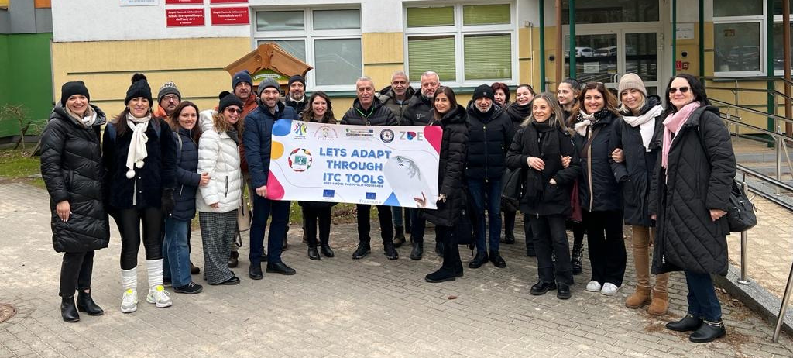
Newsletter
February 2024
Nr. 1
Erasmus+ Let’s adapt through ITC tools 2023-1-RO01-KA220-SCH-000160489
Project main objective
To increase the level of appropriate use of ICT tools in special education by teachers at school and by parents.
Our partners
Our partners:
Zespol Placowek Edukacyjnych, Olsztyn, Poland
Agrupamento de Escolas General Serpa Pinto de Cinfães, Portugal
Istituto Istruzione Secondaria Superiore "Rosa Luxemburg" , Puglia, Italy
Mev Ortaokulu, Istanbul Turkye
What do we want to achieve?
1. Exchange of good practices involving ICT tools in special education
2. Raising awareness of the negative effects of excessive use of technology on children with special needs

Slide 2
The theme of the meeting in Poland was to exchange experience on the use of ICT for communication development.
The first project meeting took place on 19-23 February 2024 in Poland, Olsztyn, at Zespol Placowek Edukacyjnych. Presentations were given on specific methods of communication development for students with ESC, we discussed digital stories, websites and platforms with interactive applications, we conducted workshops exploring tools such as C-Eye , Stop Motion Animation, Boardmaker.
The second part of the meeting in Poland was dedicated to the negative effects of the use of information media in terms of communication development in children with special needs. A number of disadvantages and recommendations concerning media use were identified:
Disadvantages:
Internet, tablet, phone, computer addiction occurs.
May increase behavioural and verbal stereotyping.
Decreases interest in participating in group, social activities.
Becomes violent, aggressive.
Has no control over the duration of use of tablet, phone, computer.
Sleep disturbances, anxiety may occur.
Difficulty concentrating.
Recommendations:
Find alternative activities, time outside, games.
Limit time in front of computer, tablet to no more than 30 minutes a day.
Fragmentation of screen time
Explain why we will use the board/computer,
Announcing when it will close/open.
Spending time together in front of the computer/tablet. Parent will explain what they are doing together on the computer.
Controlling the applications your child has access to.

